Slide 1
Week 3 – Gripper
Advanced Mechatronics System Design – MANU2451
Dr Chow Yin LAI, School of Engineering
Edited by Dr Milan Simic RMIT University, Victoria, Australia Email: milan.simic@rmit.edu.au

Slide 2
Teaching Schedule
Week |  | Class Activity Before | Lecture | Class Activity During or After
1 |  |  | Introduction to the Course / Introduction to LabVIEW | LabVIEW Programming
2 |  |  | Introduction to LabVIEW / Data Acquisition | LabVIEW Programming
3 |  |  | Gripper / Introduction to Solidworks / Safety | Gripper Design
4 |  |  | Sensors I | myRIO Programming for Sensor Signal Reading / Gripper Design
5 |  |  | Sensors II | myRIO Programming for Sensor Signal Reading
6 |  |  | Actuators I | 3D Printing
7 |  | LabVIEW Assessment. | DC Motors I | Matlab Simulink Simulation
8 |  | Design report submission | DC Motors II | Matlab Simulink Simulation / myRIO Programming for Control
9 |  |  | Actuators II | Matlab Simulink Simulation / Assemble Gripper
10 |  |  | Modeling and System Identification | Matlab Simulink Simulation / Test Gripper
11 |  |  | Artificial Intelligence I | Matlab Simulation / Finalize Gripper
12 |  | Gripper Demonstration / Submission of Report | Artificial Intelligent II | Revision

Slide 3
Content
Introduction
Gripper Mechanism
Mechanical Components
Motor and Coupler
Gears
Design for 3D Printing
Safety Induction
Gripper Design Project
Gripper Design in Team
Fill in Safety Forms
Attachment: Quick Guide to using Solidworks

Slide 4
Content
Introduction
Gripper Mechanism
Mechanical Components
Motor and Coupler
Gears
Design for 3D Printing
Safety Induction
Gripper Design Project
Gripper Design in Team
Fill in Safety Forms
Attachment: Quick Guide to using Solidworks

Slide 5
Introduction to Grippers
Gripper examples:
Two fingers https://www.youtube.com/watch?v=DW4ttbLh_kA
An integral part of robots and material handling systems.
For gripping and grasping of object.
E.g. for moving object from one place to another.

Slide 6
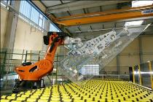
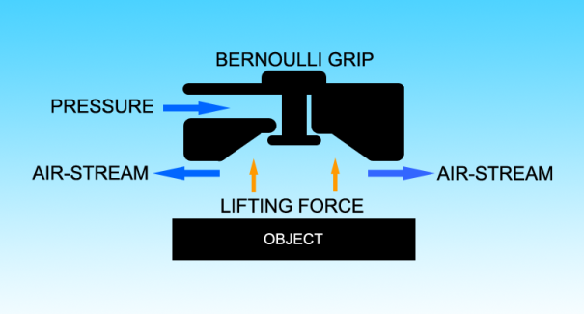
Introduction to Grippers
Gripping methods
Surface
Suction
Magnetic
Pinning
Pinching
2-Finger
3-Finger
Enclosing
2-(big)-Fingers
Multiple Fingers
Suction grippers:
Full or partial vacuum
Local pressure in the gripper area lower than ambient pressure
Full vacuum not suitable for porous materials
Magnetic grippers:
Only for ferrous materials
Pinning:
Needles pressed into object
Suction Gripper for Glass
https://commons.wikimedia.org/wiki/File:KUKA_robot_for_flat_glas_handling.jpg
Bernoulli Gripper
https://commons.wikimedia.org/wiki/File:Bernoulli_Gripper.png

Slide 7
Introduction to Grippers
Gripping methods
Surface
Suction
Magnetic
Pinning
Pinching
2-Finger
3-Finger
Enclosing
2-(big)-Fingers
Multiple Fingers
Pinching gripper is the original gripper concept for robots.
Simple, robust and efficient.
The fingers are either flat-faced or have circular or v-grooves.
Two-finger flat-faced finger grippers rely solely on friction to hold the object.
Force opposing sliding along gripper surface:
N = normal force on finger face, n = no. of fingers, and µ = coefficient of friction
Object

Slide 8
Introduction to Grippers
Gripping methods
Surface
Suction
Magnetic
Pinning
Pinching
2-Finger
3-Finger
Enclosing
2-(big)-Fingers
Multiple Fingers
(a)
To avoid sliding, F_{friction} for a two-finger gripper must satisfy the following conditions depending on direction of movement.
Move up:
Move down:
N
N
m(g+a)
(b)
N
N
m(g-a)

Slide 9
Introduction to Grippers
Gripping methods
Surface
Suction
Magnetic
Pinning
Pinching
2-Finger
3-Finger
Enclosing
2-(big)-Fingers
Multiple Fingers
Enclosing grippers embraces / envelops the whole object when closed
Gripper does not pinch the object unless the object fills the gripper volume
Advantage: Handle all variations of product as long as it fits inside the gripper
Disadvantage: Does not provide exact positioning unless if object is big enough to be pinched
Object

Slide 10
Introduction to Grippers
One of the challenges in gripper research is to create a gripper which is able to pick up unfamiliar objects with various shapes and surface properties.
Some modern “Universal” grippers:
Granular jamming https://www.youtube.com/watch?v=ZKOI_lVDPpw
Granular material (e.g. Coffee ground) flows around the target object and conforms to its shape.
When vacuum is applied, the granular material contracts and hardens quickly to pinch and hold the object.
Soft robotic gripper https://www.youtube.com/watch?v=Y5kZO8SSxVw
Silicon rubber gripper
Can handle delicate objects

Slide 11
Grippers as Mechatronics System
Conventionally, grippers are rather simple devices.
Two mechanically actuated fingers can handle many objects.
Objects mostly made of hard material and can withstand hard pinching.
However, in recent years, there are new requirements and challenges:
Soft, delicate and unstructured objects. E.g. food.
Fruits, vegetables, biscuits etc. cannot be pinched tightly.
Fruits, vegetables etc. come in different sizes and shapes.
Need sensors and control
Force sensing and control to grab objects at suitable force without damaging it
Able to communicate with the robots
https://www.youtube.com/watch?v=NgZqVjcI7P0
Mechatronics!!

Slide 12
Content
Introduction
Gripper Mechanism
Mechanical Components
Motor and Coupler
Gears
Design for 3D Printing
Safety Induction
Gripper Design Project
Gripper Design in Team
Fill in Safety Forms
Attachment: Quick Guide to using Solidworks

Slide 13
Gripper Mechanism
We will focus only on two-finger grippers.
Finger trajectory:
Linear translation
Curvilinear translation
Rotation

Slide 14
Gripper Mechanism
Possible realization of the finger motion using rotary joints:
Rotary actuation can be transformed to linear motion through rack and pinion, belt and pulleys etc. (and vice versa)

Slide 15
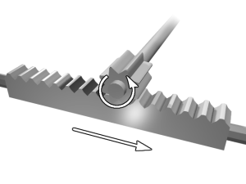
Gripper Mechanism
Possible realization of the finger motion using pinion and rack:
Rack and Pinion
https://commons.wikimedia.org/wiki/File:Rack_and_pinion.png

Slide 16
Gripper Mechanism
Possible realization of the finger motion using cam and followers joints:
Can also be circular but eccentric

Slide 17
Gripper Mechanism
Possible realization of the finger motion using screw mechanism:

Slide 18
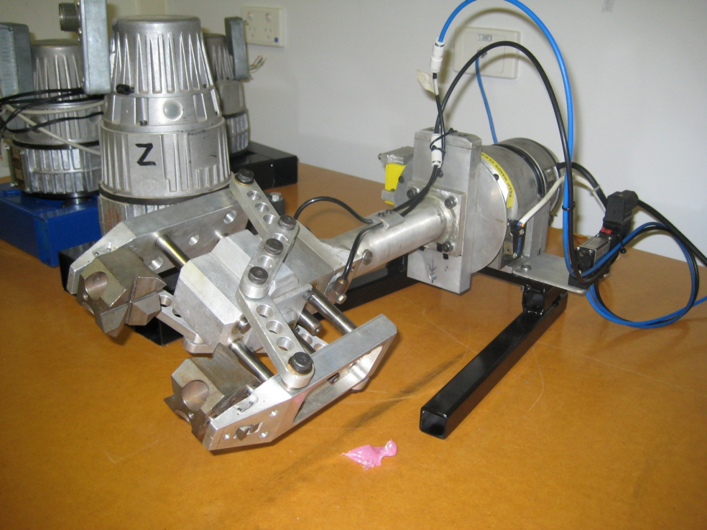
Example - Gantry Robot Gripper
Sensors and Actuators
Micro switch
Electromagnetic sensor
Rotary Encoder
DC Motor
Pneumatic Valve

Slide 19
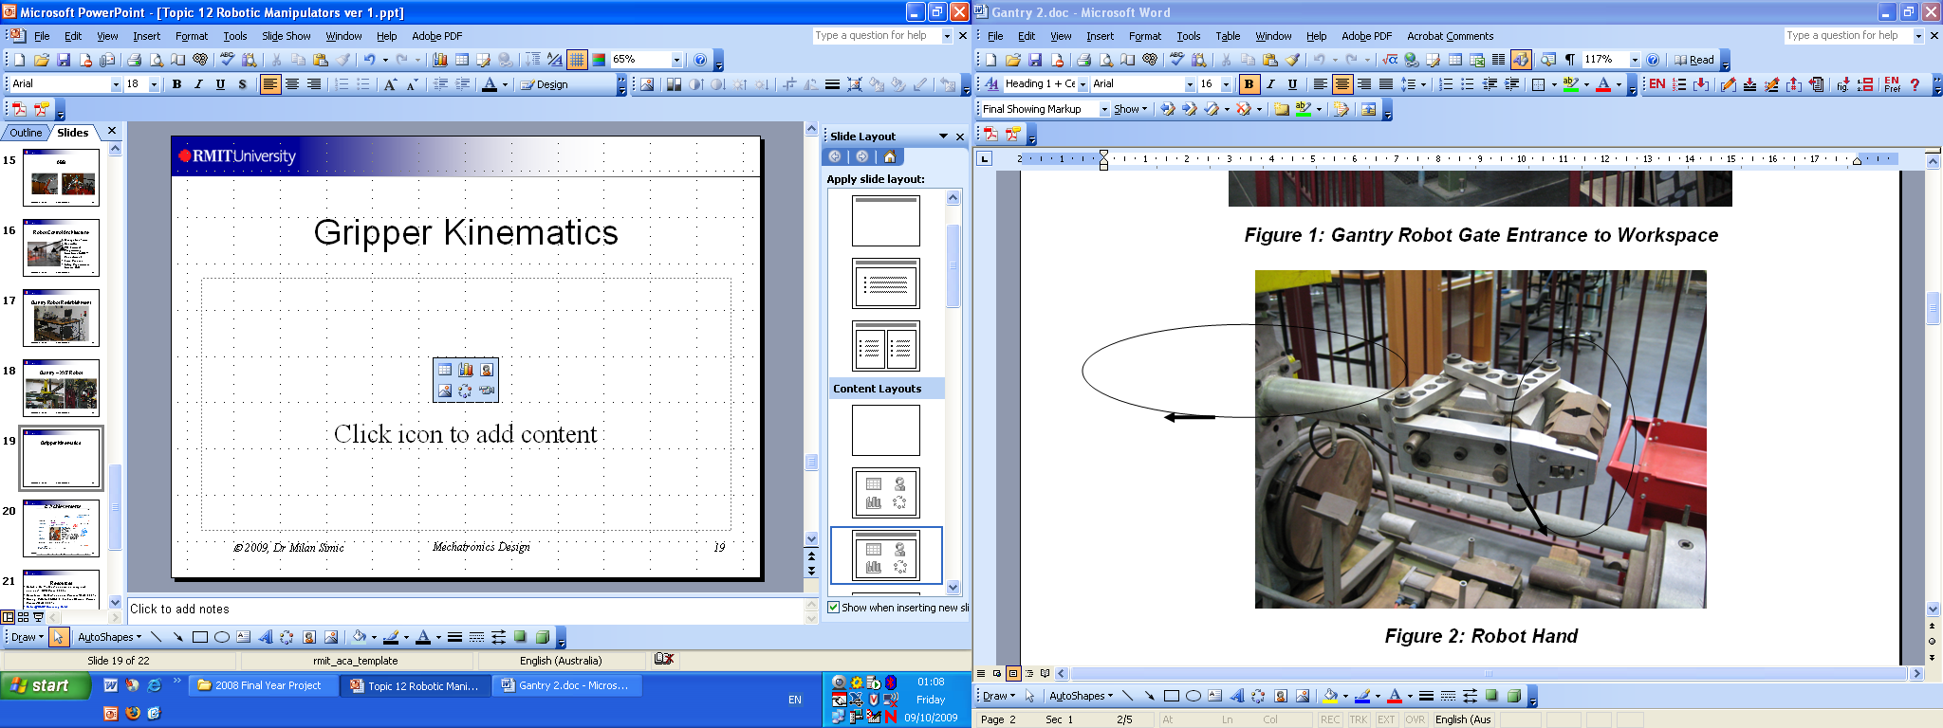
Gantry Gripper Kinematics

Slide 20
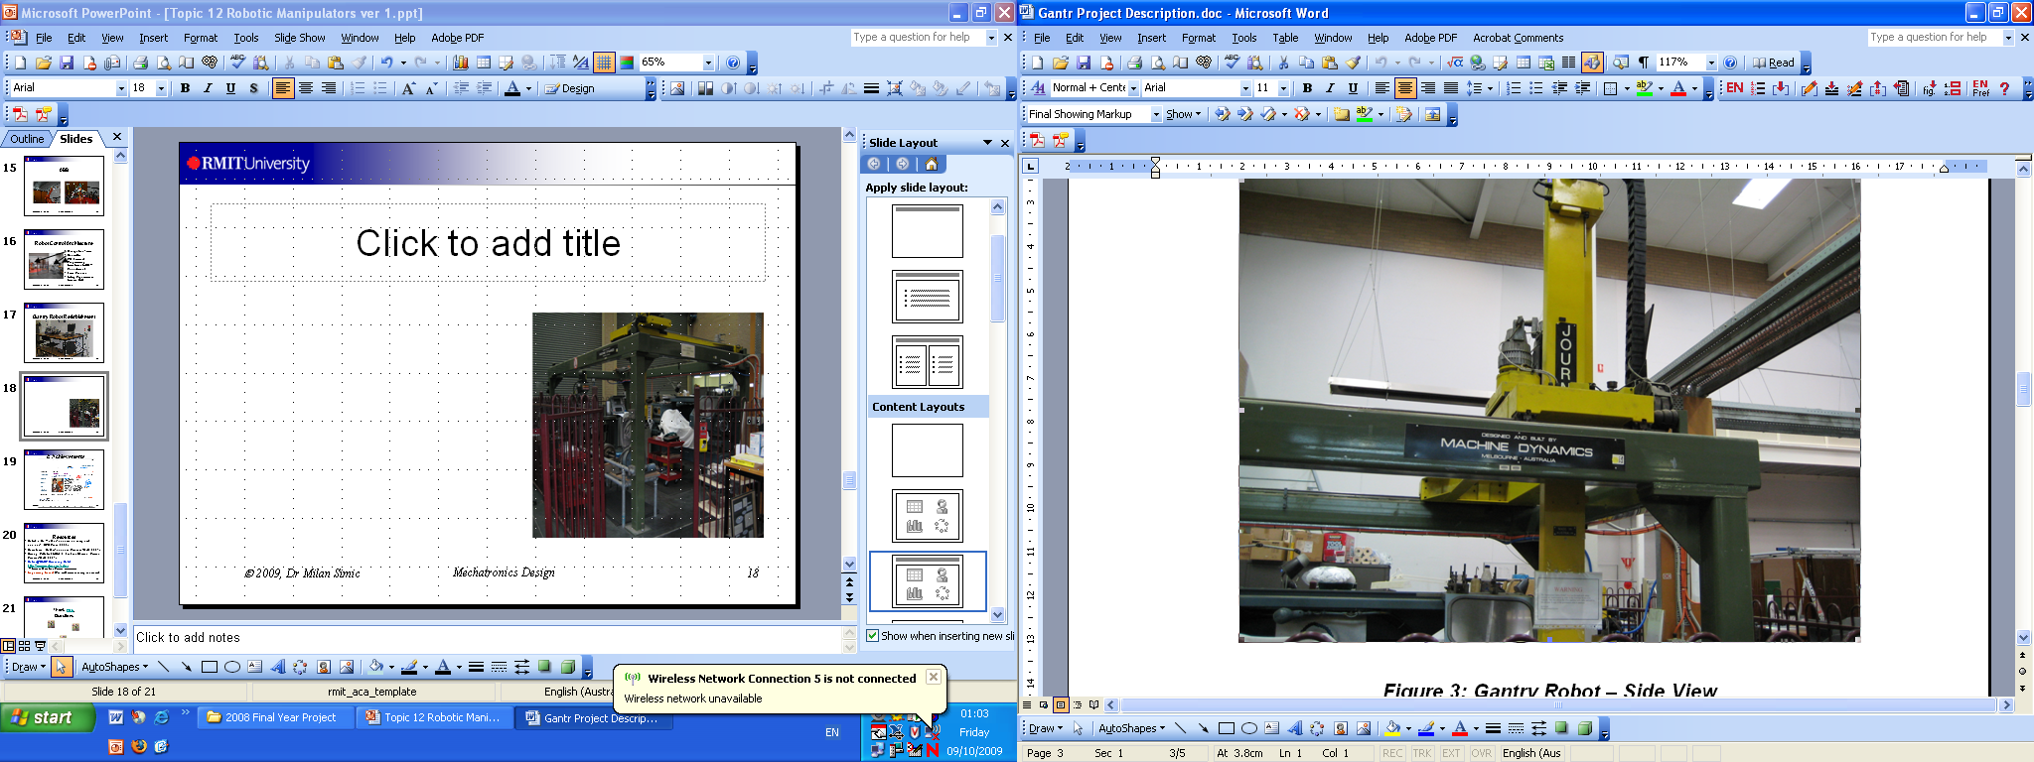
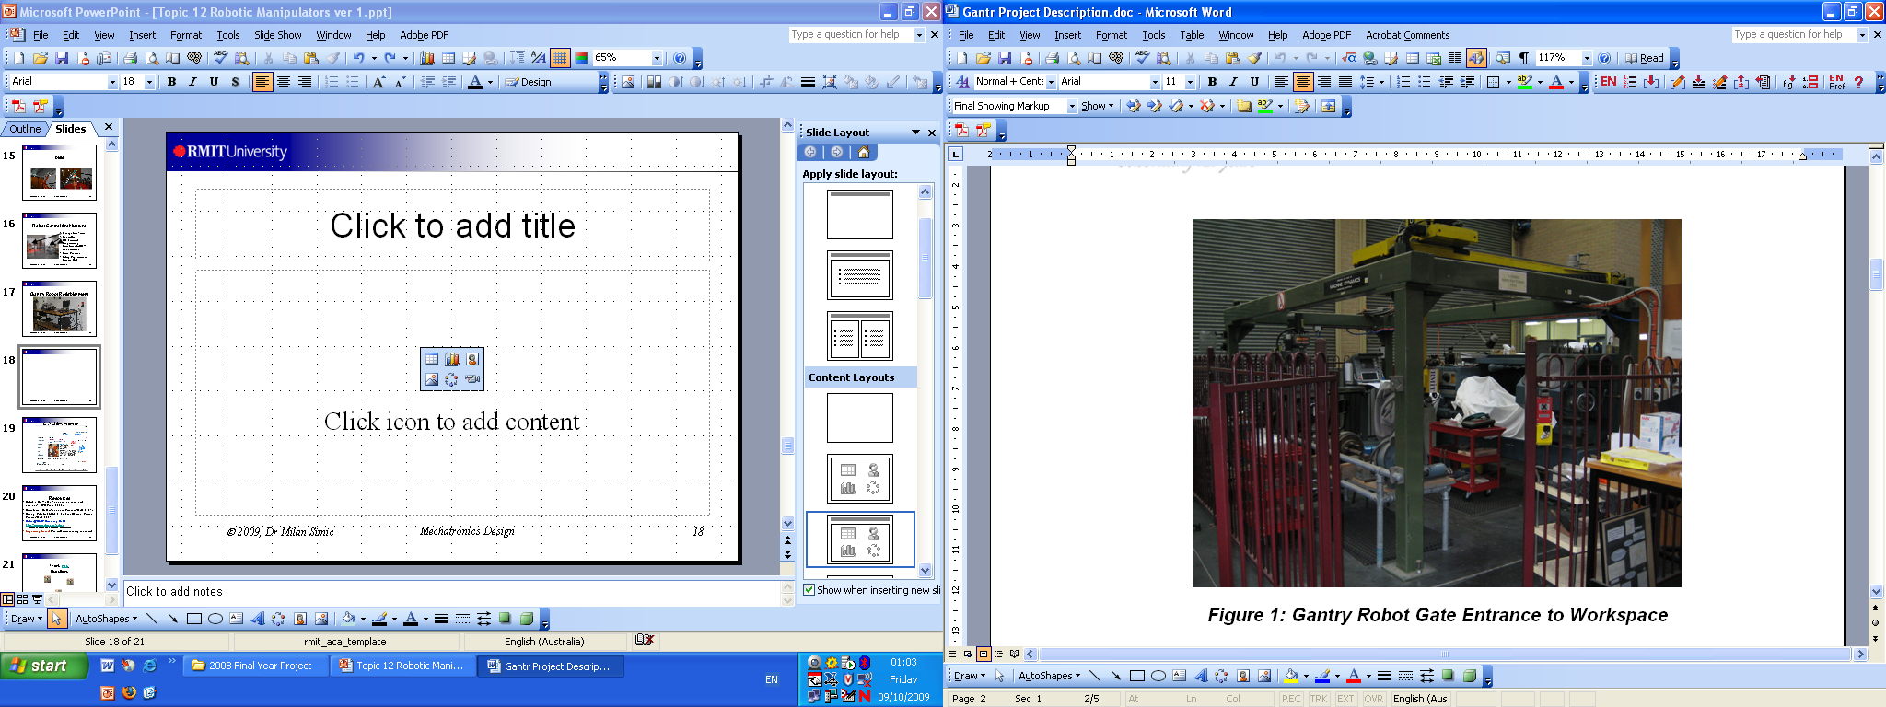
Large Gantry – XYZ Robot

Slide 21
Things to Consider for Design
Weight
Lower weight for increased acceleration and reduced cycle time
Dimensions
Workpiece
Work area clearance
Range of Parts
Adjustable
Usage of inserts
Rigidity
Maintain accuracy
Reduce vibrations
Force level
Maximum force for safety / workpiece
Minimum force for gripping

Slide 22
Things to Consider for Design
Maintenance
Should be easy and fast
Compliance
Helps guide work into out-of-alignment conditions
Sensors
Check for parts not in gripper
Gripper changer
Make a robot multifunctional
Usage environment
Protection against fluid, temperature, dust etc.
https://www.youtube.com/watch?v=gQ7-VgQXSU0

Slide 23
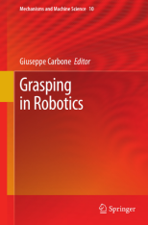
Further References
Gripper Technologies for Food Industry Robots by T. K. Lien, in Robotics and Automation in the Food Industry, Chapter 7, pp. 143-170, Elsevier Science.
Robotic Systems by G. Onwubolu, in Mechatronics, Chapter 15, pp. 531-555, Butterworth Heinemann.
Grasping in Robotics by G. Carbone (Ed), Publisher: Springer

Slide 24
Content
Introduction
Gripper Mechanism
Mechanical Components
Motor and Coupler
Gears
Design for 3D Printing
Safety Induction
Gripper Design Project
Gripper Design in Team
Fill in Safety Forms
Attachment: Quick Guide to using Solidworks

Slide 25
Review of Mechanical Components
We saw earlier that to realize the finger pinching motion, it is often necessary to translate linear motion to rotary motion, and vice versa.
Also, most motors which are used in mechatronics devices provide high speed but low torque / force.
If the required gripping force is higher than what can be provided by the motor, we will need a gear to increase the torque.
In this section, we will have a review of a few mechanical components (which you might need for the gripper design project).

Slide 26
Motor: How to attach load onto shaft
The motors usually have a shaft with a D-shape cross section.
Load with hole can be secured to the motor shaft using a set screw.
Set screw
Load – to make use of the rotary motion from motor

Slide 27
Motor: How to attach load onto shaft
If the load doesn’t have a “pipe”-like section, then a coupler can be used to connect the load and motor.
Set screw
Load – to make use of the rotary motion from motor
Coupler

Slide 28
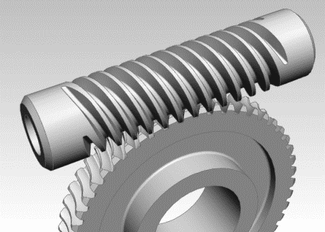
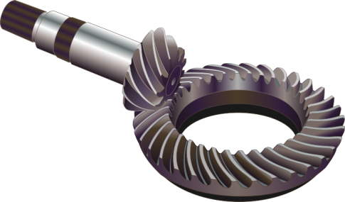
Gears
Rotating machine part with teeth, meshes with another toothed part to transmit torque. Four principle types:
https://commons.wikimedia.org/wiki/File:Gear-kegelzahnrad.svg
https://commons.wikimedia.org/wiki/File:Worm_Gear.gif
Spur Gears
Teeth parallel to axis of rotation
Transmit motion from one shaft to another parallel shaft
Helical Gears
Teeth inclined to axis of rotation
Less noisy due to gradual engagement of teeth
Can be used for non-parallel shafts
Bevel Gears
Teeth formed on conical surfaces
Transmit motion between intersecting shafts
Straight tooth, spiral tooth, hypoid
Worm Gears
Worm resembles screw
Can achieve high gear ratio
Self-locking

Slide 29
Gears
Nomenclature (Spur gear):
Module: Ratio of pitch diameter (i.e. diameter of pitch circle) to the Number of teeth:
Thus for different gears of same module, the diameter is proportional to the number of teeth.
Circular pitch
Addendum circle
Addendum
Pitch circle
Dedendum
Dedendum circle

Slide 30
Gears – Speed Reduction
The most important reasons for using gears are to change the speed, torque and direction.
Speed:
When two gears are in mesh, their pitch circles roll on one another without slipping.
If gear 1 and 2 have pitch radii and angular velocity respectively, then the pitch line velocity is:
Thus the relation between the radii on the angular velocities is
Base circle
“Driven gear”
Pitch circle
“Driving gear”

Slide 31
Gears – Torque Amplification
Torque which a motor can provide is usually proportional to its size.
If high torque is required:
Either use a big and powerful motor: Direct drive thus no backlash, but big size, heavy and costly.
Or use a smaller motor (with lower torque) and use gears to increase the torque:
Assume no frictional loss, then input power equals output power:
Substitute equation from previous slide, we have:

Slide 32
Gears – Imperfection
Efficiency
Efficiency is the ratio of output power to input power.
If efficiency is 100%, then the torque amplification in previous slide holds.
However, if efficiency is less then 100%, the torque equation becomes:
Assume speed transmission is not affected by efficiency since the teeth are physically constrained to have same linear speed at point of contact

Slide 33
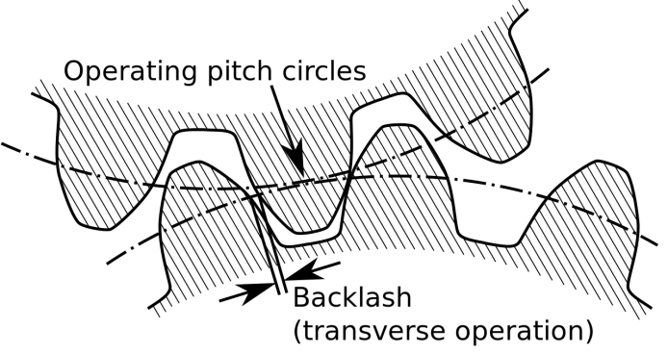
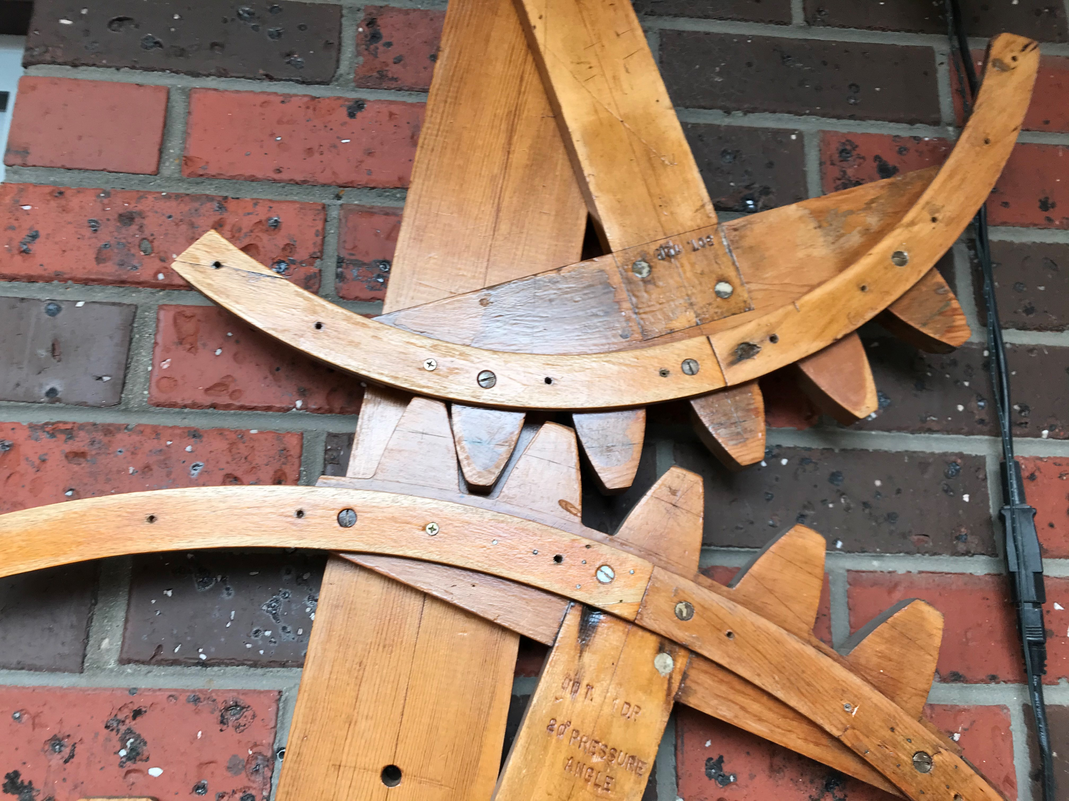
Gears – Imperfection
Backlash
Error in motion that occurs when gears change direction.
Due to gap between trailing face of the driving tooth, and the leading face of the tooth behind it.
Gap must be closed before force can be transmitted.
Backlash
https://commons.wikimedia.org/wiki/File:Backlash.svg

Slide 34
Content
Introduction
Gripper Mechanism
Mechanical Components
Motor and Coupler
Gears
Design for 3D Printing
Safety Induction
Gripper Design Project
Gripper Design in Team
Fill in Safety Forms
Attachment: Quick Guide to using Solidworks

Slide 35
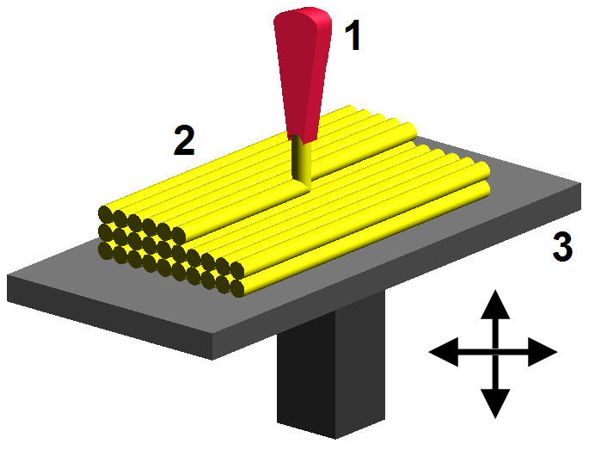
Introduction to 3D Printing
3D Printing: Object is created by laying down successive layers of material until the entire object is created.
There are different technologies to 3D Printing.
The 3D Printer which we will use makes use of the Material Extrusion technology, “Fused Deposition Modeling (FDM)”.
Nozzle is heated to melt the material.
The molten material is then deposited by extrusion head.
The extrusion head is moved horizontally and vertically to build the object layer by layer.
FDM
https://commons.wikimedia.org/wiki/File:FDM_by_Zureks.png

Slide 36

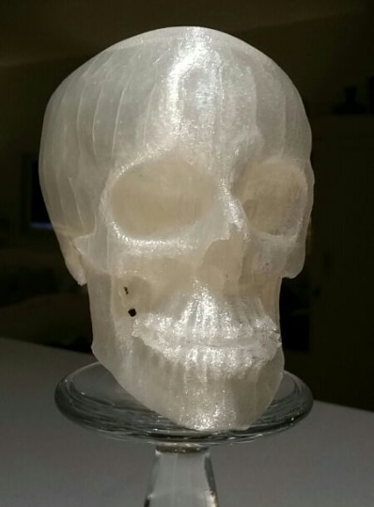
3D Printing Materials
Most commonly used plastic material:
ABS (Acrylonitrile Butadiene Styrene):
Durable and strong, slightly flexible.
Warping; Non-biodegradable.
Needs heated base during printing.
PLA (Polyactic Acid):
Biodegradable, derived from renewable resources.
Tough but brittle. Less warping issues.
Lego Bricks
https://commons.wikimedia.org/wiki/File:Lego_Color_Bricks.jpg
PLA Skull
https://commons.wikimedia.org/wiki/File:3D_Printed_Macrognathism.jpg

Slide 37
Tips for 3D Printing Design
Minimum Wall Thickness
ABS and PLA: 1mm
If wall thickness is too thin:
Fragile and break off easily. Or:
Unable to be printed at all.
https://www.3dhubs.com/knowledge-base/pla-vs-abs-whats-difference/#what-are-abs-and-pla

Slide 38
Tips for 3D Printing Design
Clearance:
When printing a peg and a hole:
If both are designed to be 3mm in diameter, most likely the peg will not fit into the hole.
Due to printing accuracy of about 0.2mm.
Also due to thermal expansion and contraction.
Suggested minimum clearance: 0.6mm.

Slide 39
Content
Introduction
Gripper Mechanism
Mechanical Components
Motor and Coupler
Gears
Design for 3D Printing
Safety Induction
Gripper Design Project
Gripper Design in Team
Fill in Safety Forms
Attachment: Quick Guide to using Solidworks

Slide 40
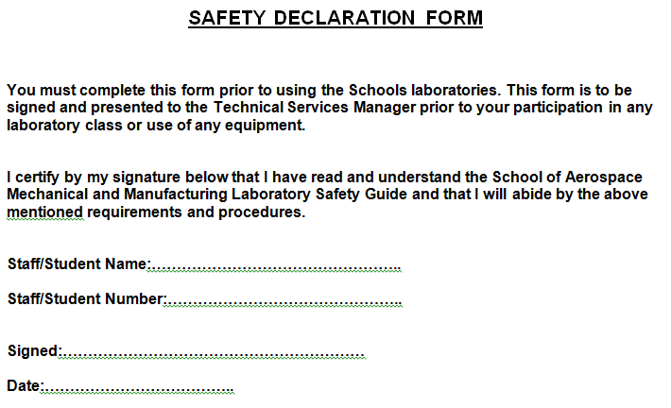
Safety Declaration Form (Individual)
Everyone must complete and sign this form.
Please scan and email me in pdf form.

Slide 41
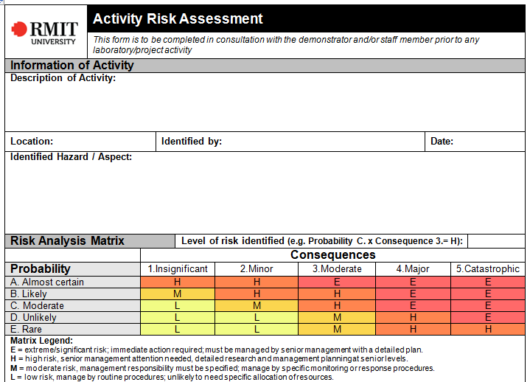
Risk Assessment Form (Team)
This is to be completed in team.
Please scan and email me in pdf form.
Give detail
Group leader
E.g. Using drills – injury to finger (C x 3 = H)
Write as much as you think of.

Slide 42
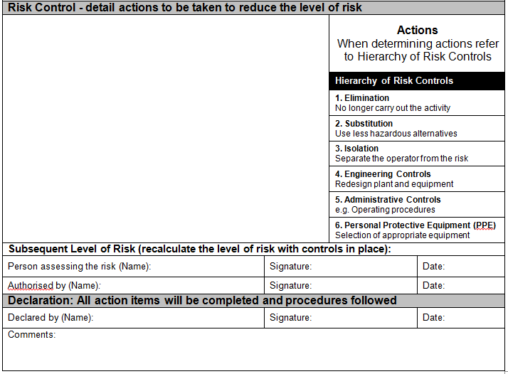
Risk Assessment Form (Team)
Continued…
E.g. use G-clamp instead of holding workpiece by hand. (E x 3 = M)

Slide 43
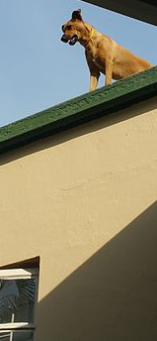
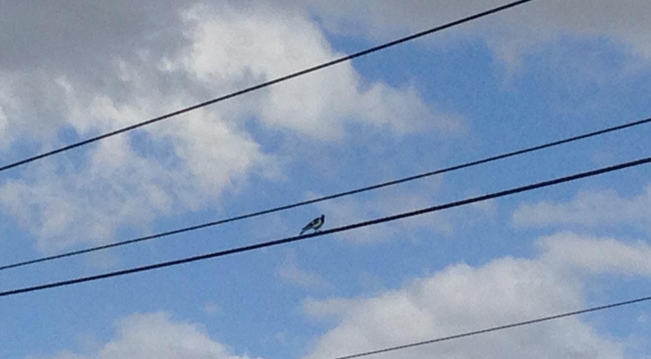
Could Electrical Potential Kill ?
Could Potential Difference, i.e. Voltage Kill?

Slide 44
Current Kills
R_{body} ≈ 1K Ω = 1000 Ω,
Depends on moisture, wetness
Could be more, but much less as well!!!
Dangerous Current is 14mA = 0.014 A, More can Kill!!!
Car Battery = 12V, … DC
AC Power 240, 50Hz AC

Slide 45
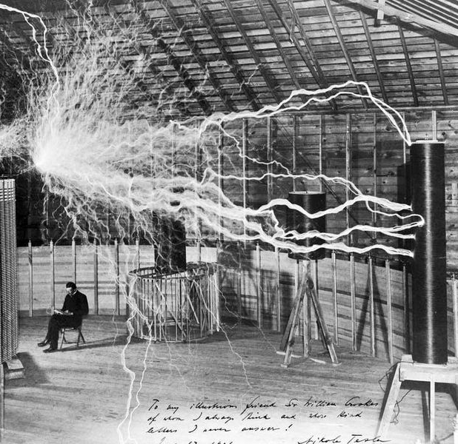
High Frequency, Voltage and Current Tesla Current
High Frequency Current travel on the surface
Not through the body

Slide 46
Content
Introduction
Gripper Mechanism
Mechanical Components
Motor and Coupler
Gears
Design for 3D Printing
Safety Induction
Gripper Design Project
Gripper Design in Team
Fill in Safety Forms
Attachment: Quick Guide to using Solidworks

Slide 47
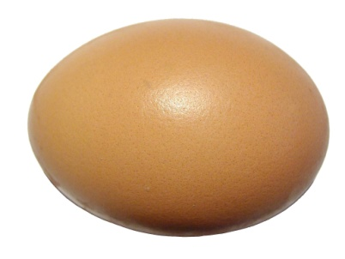
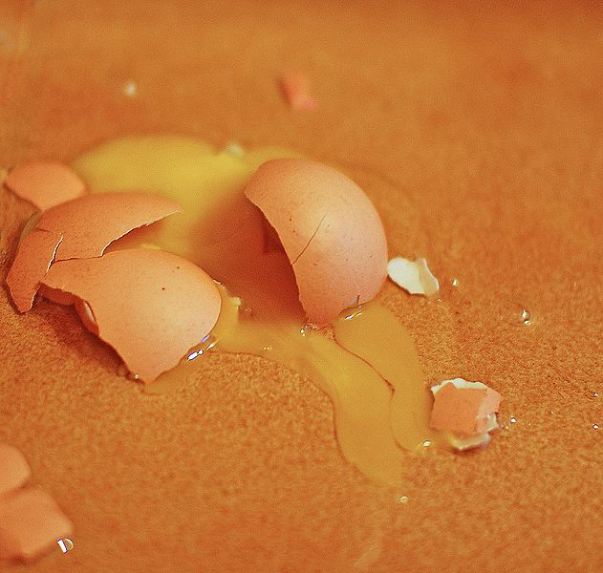
Gripper Project
You will make a gripper with the following requirements:
Position controlled
Force controlled:
Mechanism strong enough to pinch with force up to 50N.
However, we use sensor and control the force in order not to break an egg!
Some parts will be given:
DC Motor with integrated encoder
National Instruments myRIO
Motor driver (Sabertooth)
IR range sensor
Force sensor
https://commons.wikimedia.org/wiki/File:Egg_on_white_background.jpg
https://commons.wikimedia.org/wiki/File:Broken_egg_orange.jpg

Slide 48
Gripper Project
Some info on the parts provided:
Check vendor website for datasheet, dimension, drawings
No. | Item | Details | Vendor & Part number
1 | Geared motor with integrated encoder | 172:1 Metal gearmotor; 25D x 56L mm; 6V: 56RPM & 250mA Stall: 2.48Nm & 6.5A (Suggest to use 1/3 only i.e. 0.8Nm) Encoder approximately 8246 counts per revolution | RobotGear SKU-003141
2 | Motor Driver | Sabertooth Dual 5A DC Motor Driver 5A continuous 10A peak | Littlebird DF-DRI0012
3 | Loadcell An Industrial Weighing Scale | Disc type; 5-50kg force; 20mm x 11mm | www.htc-sensor.com TAS606
5 | IR distance sensor | IR distance sensor includes cable (4-30cm) | Littlebird GP2Y0A41SK0F
6 | Breadboard | Half-Size Breadboard | Littlebird DF-FIT0096
7 | Controller | National Instruments myRIO | National Instruments

Slide 49
Gripper Project
1
Components to include:
Force sensor
IR Range sensor
Reflective surface
Potentiometer (Optional)
Motor with Encoder
Make sure 2 & 3 are not obstructed by the egg. They are used to measure the opening of gripper, not the distance to the egg!
3
2
Mechanisms, gears of your own choice
4
5

Slide 50
Gripper Project
Connections:
1
Amplifier
AI
3
2
AI
myRIO
Mechanisms, gears of your own choice
DI if Encoder
AI if Potentiometer
AO
4
Sabertooth
5

Slide 51
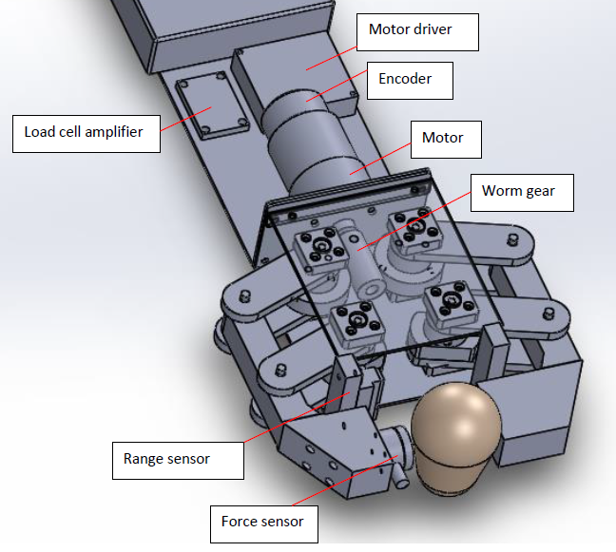
Gripper Project
Sample Design

Slide 52
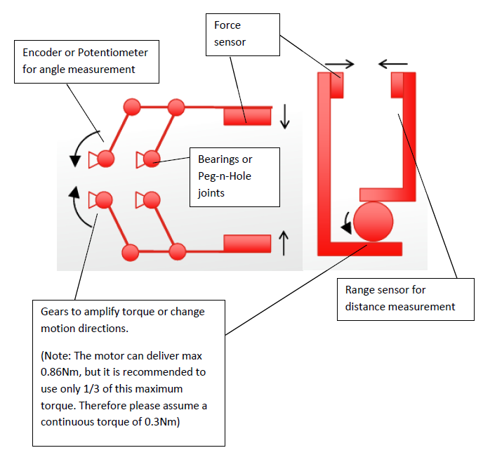
Gripper Project
Sample Design
Bonus will be given if your design is NOT one of these!
(Note: The motor can deliver max 2.48Nm, but it is recommended to use only 1/3 of this maximum torque. Therefore please assume a continuous torque of 0.8Nm)
Make sure sensor not obstructed by egg

Slide 53
Gripper Project
You will:
Form a team of 3 members
Ideally with diversed background.
Design a gripper.
Purchase own standard parts (Gears, resistors, screws, washers etc.)
Suggested places to buy materials and components:
Shops: Bunnings, Jaycar
Online: RS Online, Element14, Littlebird, Australianrobotics, Misumi, DFRobot, Core Electronics, Digikey
Mechanical
Computer
Electrical / Electronics
Control Systems

Slide 54
Gripper Project
You will (continued):
3D Print, fabricate and assemble the gripper.
Program LabVIEW to
Read in sensor signals (encoder, force sensor, IR measurement etc.) using NI myRIO.
Control the motor to achieve desired outcome, i.e. Position control and force control of the gripper.
Test and demonstrate the gripper!
... and submit a report at the end of the semester.
Have Fun!
Refer to Marking Rubric in Canvas

Slide 55
Let’s Get Started!
Form the team:
Provide name of team members.
Obtain electronic components and mechanical toolbox
Sign and submit loan form
Risk Assessment & Safety Declaration forms.
Discuss and complete these safety forms in team.

Slide 56
Let’s Get Started!
Start your design, calculations etc.
You may start with pen-and-pencil sketches first, before designing in details in Solidworks.
Think about:
What finger trajectory to have: Linear, Curvilinear, Rotary
What mechanisms to use: Rotary joints, rack and pinion, cam and follower, belt and pulley etc.
What actuation mode to use: Given the rotary motor, do you want to have pure rotary motion? Or do you want to transform the rotary motion to linear motion?
How much should the dimension be? Gripper opening must be bigger than an egg.
How much force is needed to break an egg? How much torque amplification is needed? What gears are needed to achieve this?

Slide 57
Let’s Get Started!
You are free to discuss and design until 9.30pm this evening.
Thank you and have a good evening!

Slide 58
Content
Introduction
Gripper Mechanism
Mechanical Components
Motor and Coupler
Gears
Design for 3D Printing
Safety Induction
Gripper Design Project
Gripper Design in Team
Fill in Safety Forms
Attachment: Quick Guide to using Solidworks

Slide 59
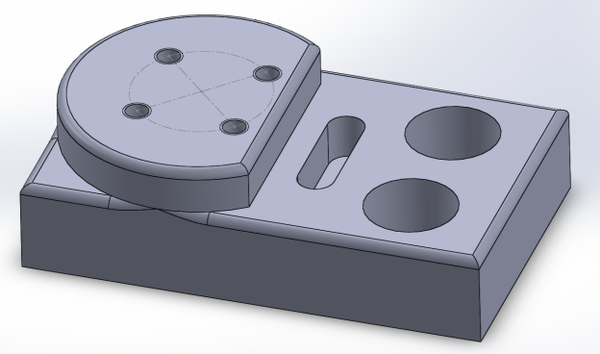
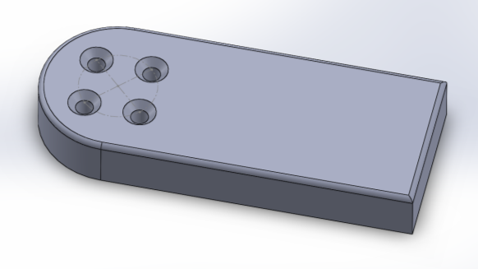
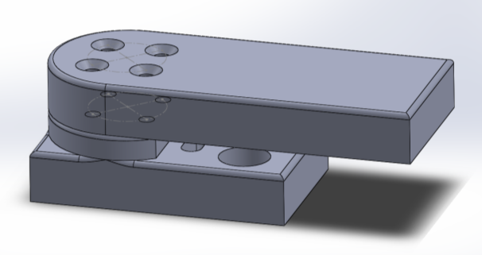
Quick Guide to Solidworks
These notes are for your self-study / reference only.
Create Parts
Sketch
Dimensions
Extrude
Add features
Cuts
Trim
Hole wizard
Fillet
Create Assembly
Insert parts
Mate

Slide 60
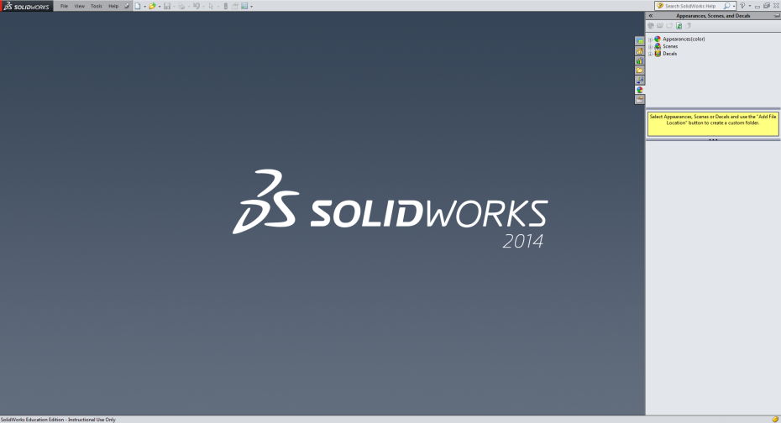
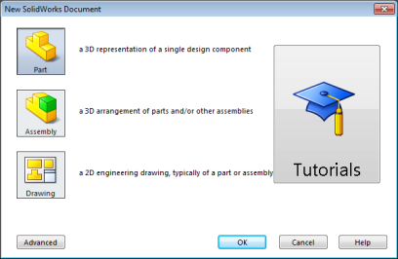
Creating a Part
1. Start Solidworks
2. File → New → Choose “Part”

Slide 61
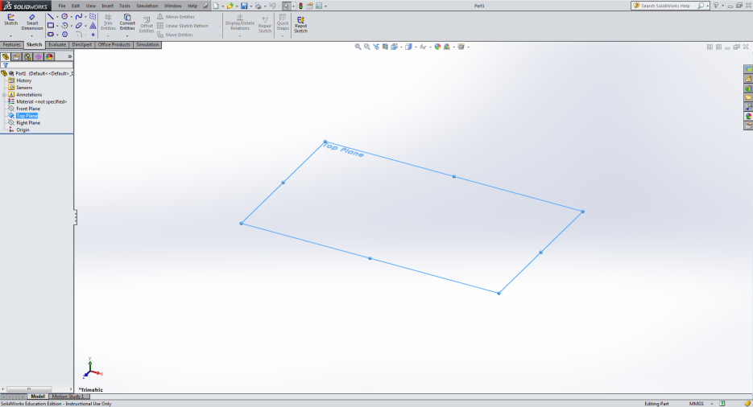
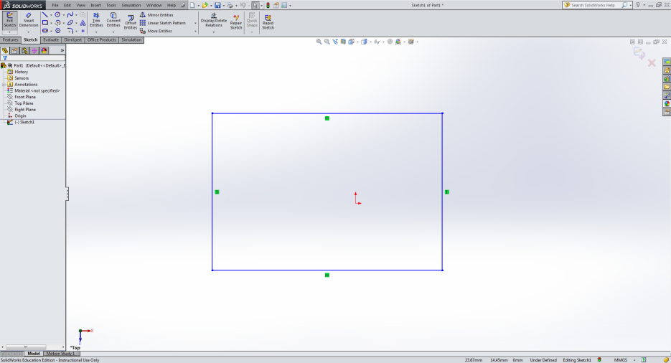
Draw the Base
3. From the tree (Feature Manager) on the left hand side, choose the appropriate plane (here: top plane)
4. From the “Sketch” tab on the top, choose the basic shape (here: rectangle) → drag across the chosen plane
Line colors:
Blue: Under-defined
Black: Fully defined
Red: Over-defined (not solved)
Yellow: Over-definde (conflict)
Brown: Dangling

Slide 62
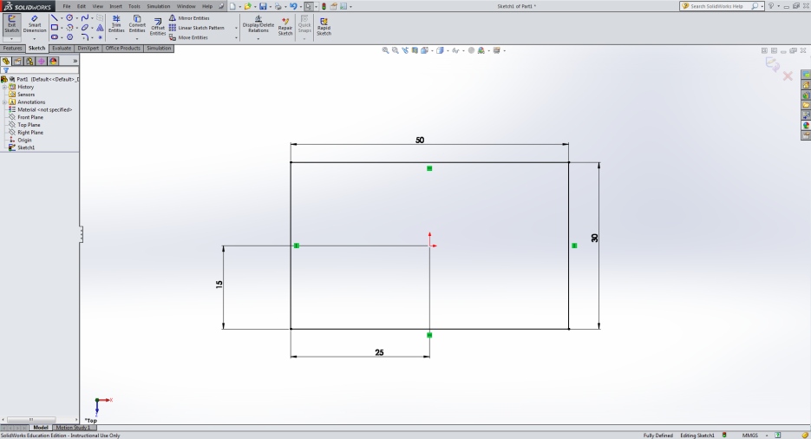
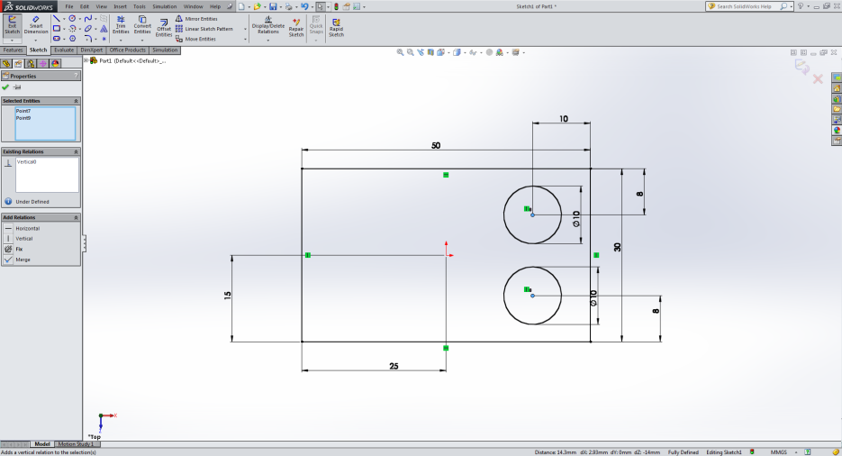
Draw the Base
5. To give dimension: Click “Smart Dimension” from the top → Click on the lines (and a reference) → Key in desired value
6. Add in any other features on this “base”, and remember to add the dimensions

Slide 63
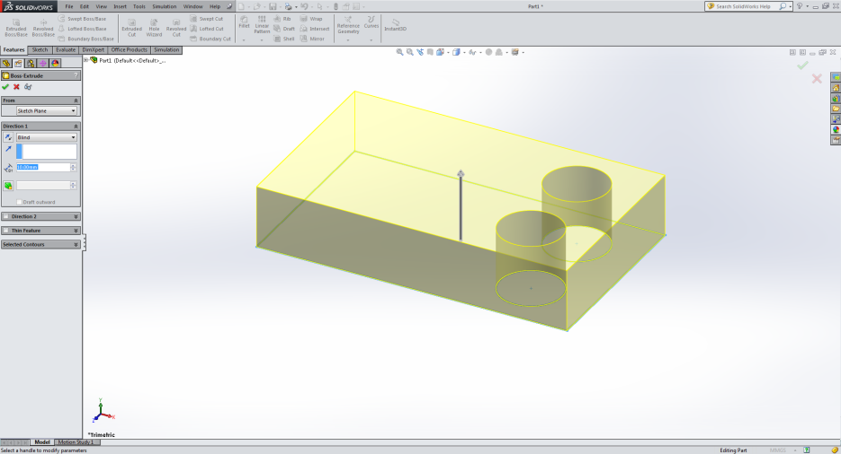
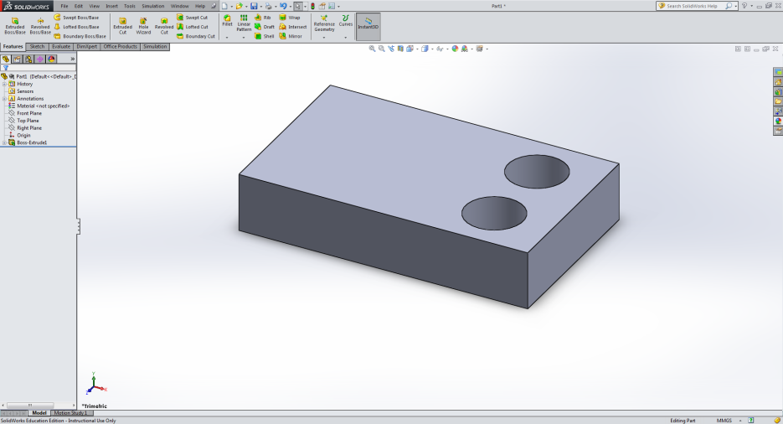
Create the Extrusion
7. When sketch is completed, click “Exit Sketch” on the top.
Highlight “Sketch1” on the tree.
Go to “Feature” tab on the top → Select “Extruded Boss / Base” → Key in desired thickness (You can see a preview)
8. Click the “Tick” button to finish.
Notice the tree now lists “Boss-Extrude1”, with “Sketch1” at the lower level.

Slide 64
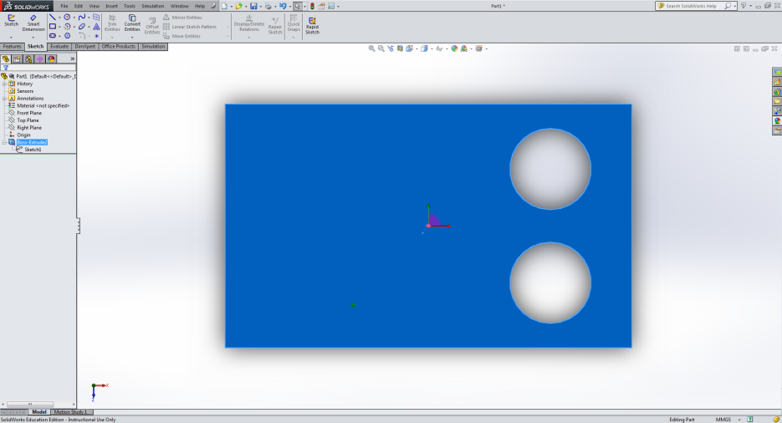
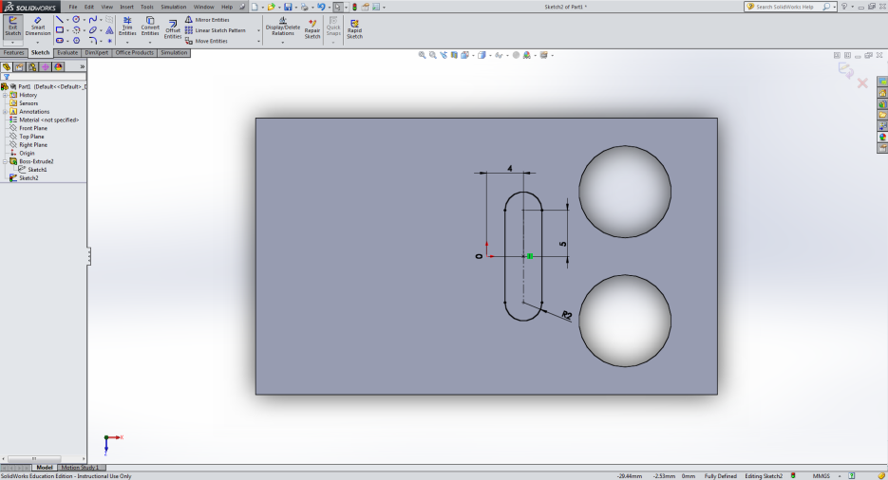
Add Features on Surface
9. Suppose you want to add features on the top surface → Click on the surface → Right click → Select “Normal To” button
10. From the “Sketch” tab, select the desired shape → drag across the surface → Add dimension using “Smart Dimension”

Slide 65
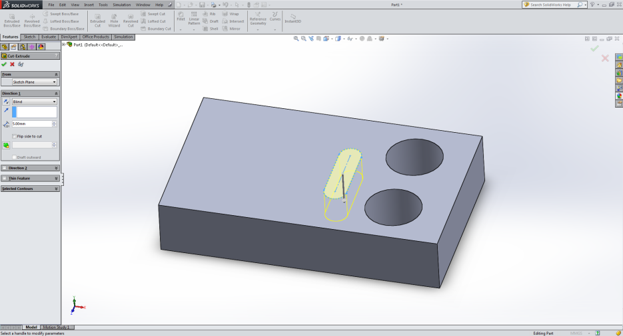
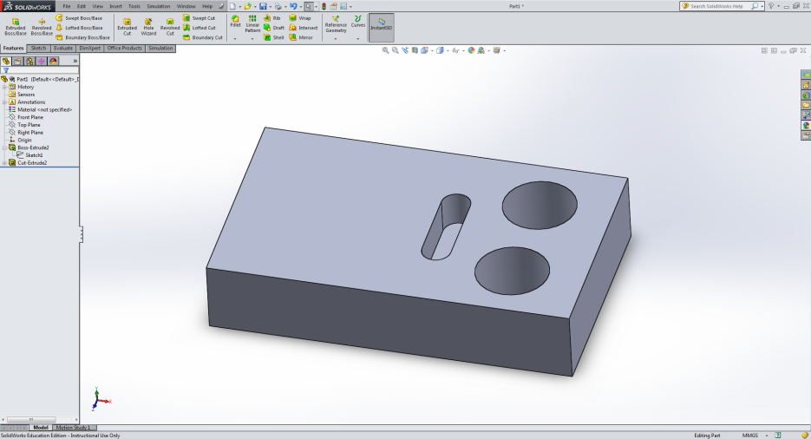
Add Features on Surface
11. When sketch is completed, click “Exit Sketch” on the top.
Highlight “Sketch2” on the tree.
Go to “Feature” tab on the top → Select “Extruded Cut” → Key in desired depth of cut (You can see a preview)
12. Click the “Tick” button to finish.
Notice the tree now lists “Cut-Extrude1”, with “Sketch2” at the lower level.

Slide 66
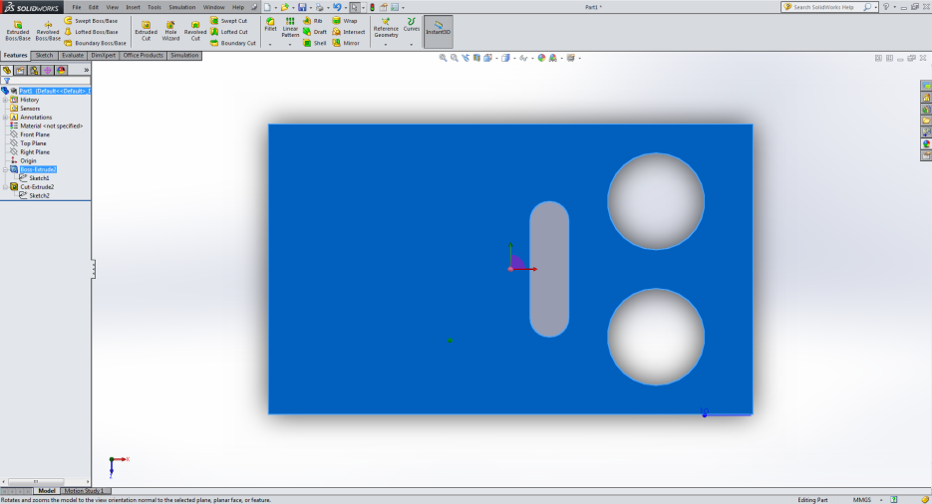
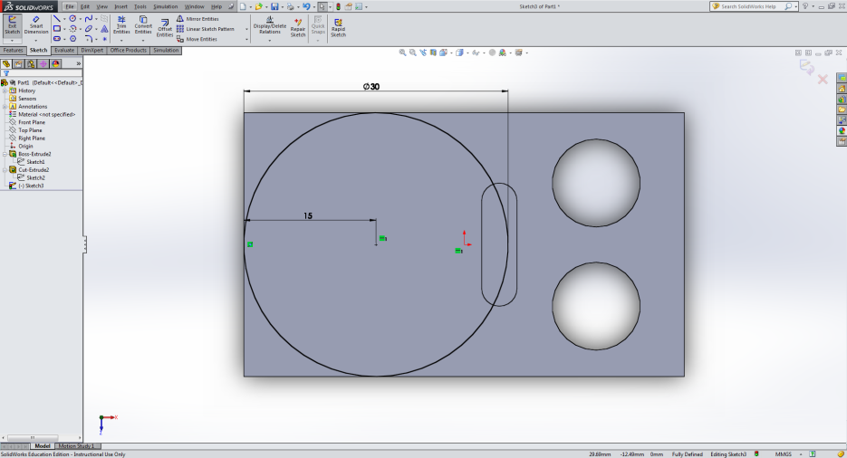
Add Features on Surface
13. Again, to add another feature on the top surface → Click on the surface → Right click → Select “Normal To” button
14. From the “Sketch” tab, select a circle → drag across the surface → Add dimension using “Smart Dimension”

Slide 67
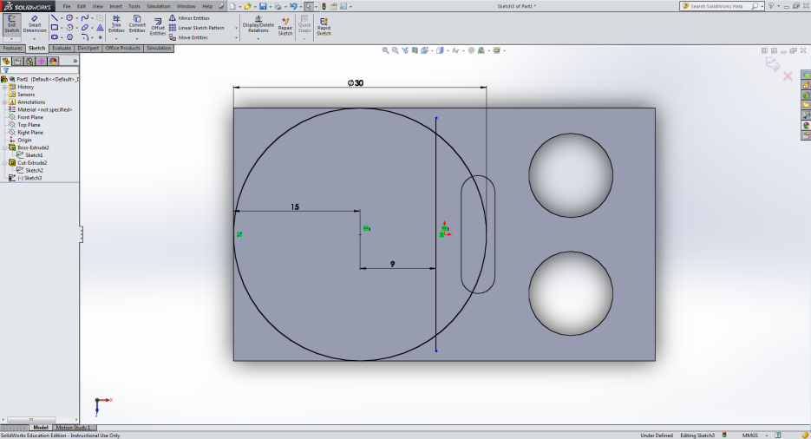
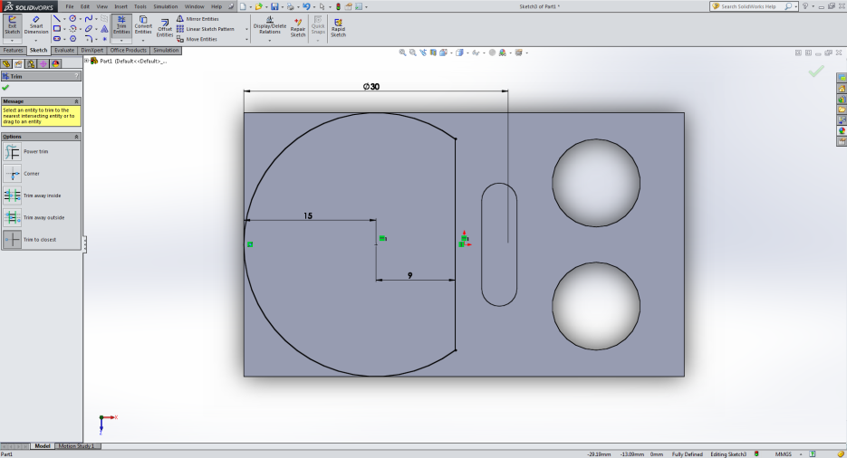
Add Features on Surface
15. Add another line across the circle but closer to the straight slot
16. Click “Trim Entities” from the top → Choose “Trim to Closest” → Trim away parts of the line and the circle

Slide 68
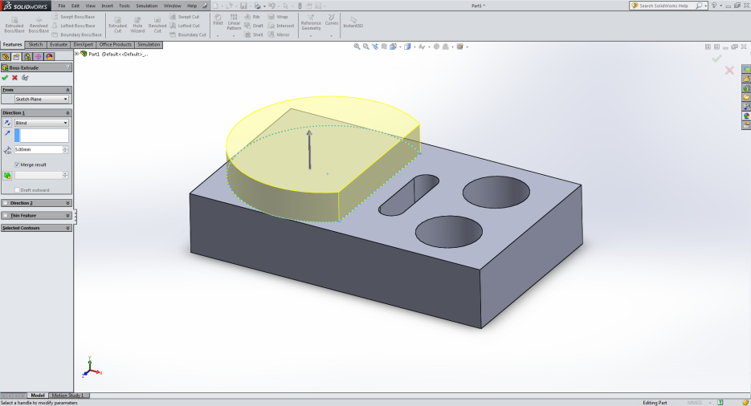
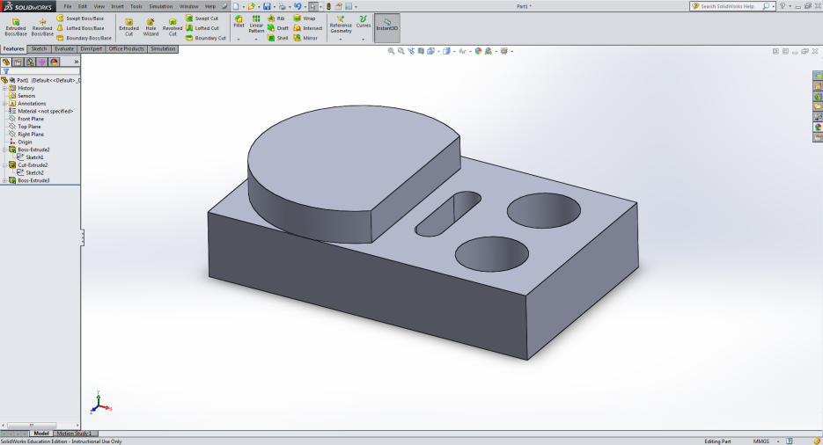
Add Features on Surface
17. Click “Exit Sketch” on the top.
Highlight “Sketch3” on the tree.
Go to “Feature” tab on the top → Select “Extruded Boss / Base” → Key in desired height (You can see a preview)
18. Click the “Tick” button to finish.
Notice the tree now lists “Boss –Extrude2”, with “Sketch3” at the lower level.

Slide 69
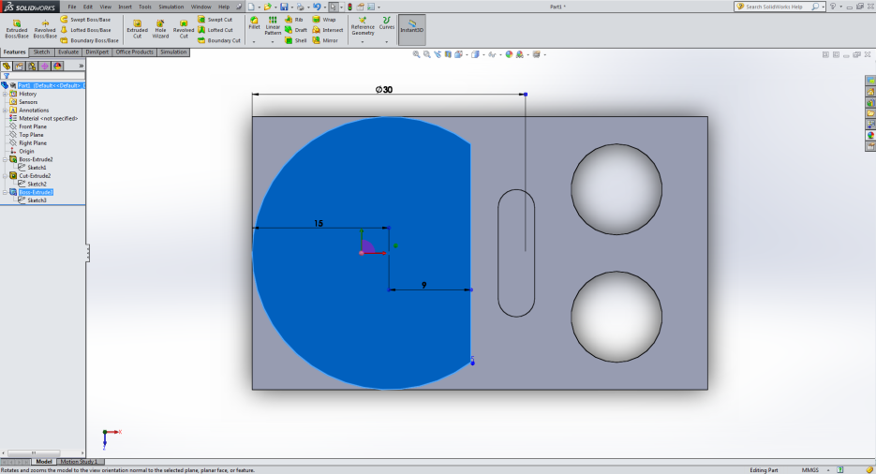
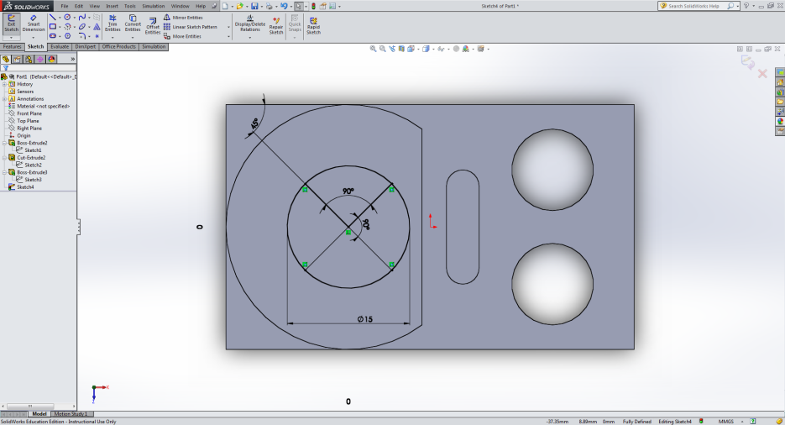
Add Screw Holes
19. Click on the surface where you want to add in screw holes → Click on the surface → Right click → Select “Normal To” button
20. Sketch the positions of the holes (Recap: Sketch, dimension, trim)

Slide 70

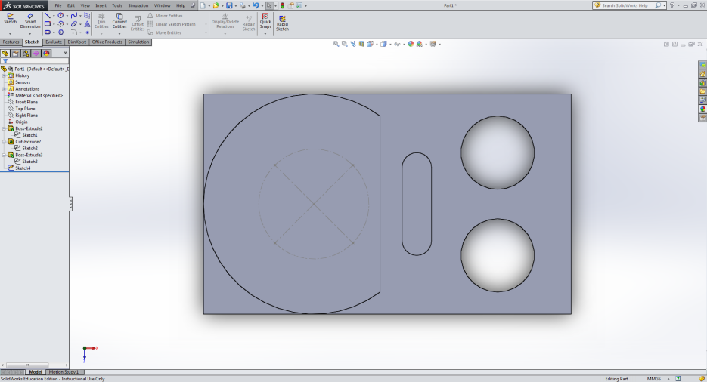
Add Screw Holes
21. We want to define those lines as “construction lines”, which are only used for construction but not to be part of features.
Right click on the lines → Select “Construction Geometry” → Notice that the lines become dashed
22. Choose “Point” from the sketch tab → place points at the end of the lines → Exit sketch

Slide 71
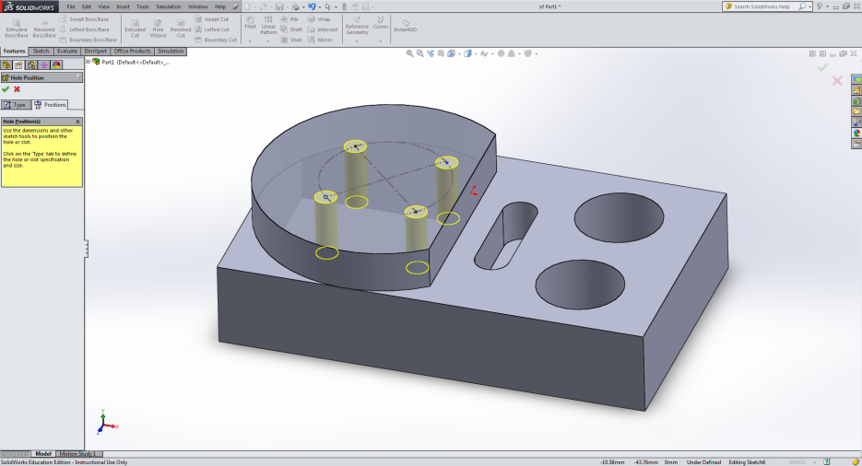
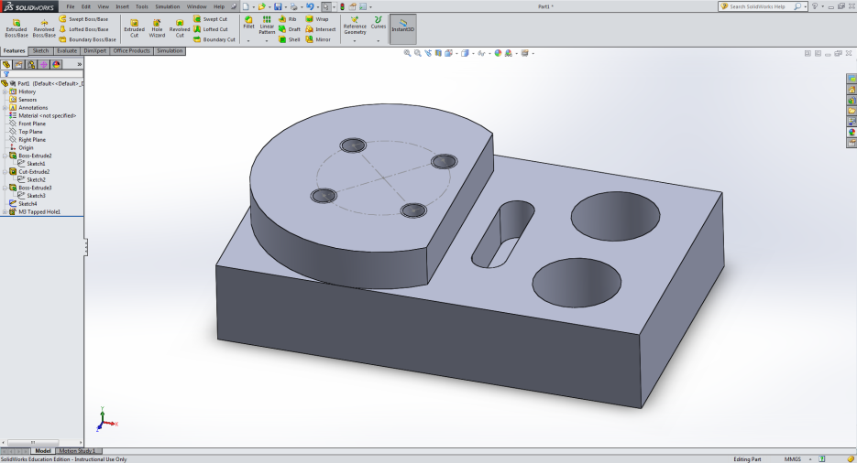
Add Screw Holes
23. From “Feature” tab, select “Hole Wizard” → Select appropriate hole type, dimension etc. → “Position” Tab → Click on the points created earlier (you may need to click on the surface) → See the preview
24. Press “Tick” and we have an almost complete part.

Slide 72

Add Fillet / Chamfer
25. We cam add fillet / chamfer to reduce the sharpness along the edges. Go to “Feature” → Fillet / Chamfer → key in desired dimension → click on the edges → “Tick” → Part complete!
Save!
26. You are encouraged to explore other features on Solidworks such as revolved bass, linear / circular pattern, mirror etc.
→ Please refer reference book or resources from the internet.

Slide 73

Create Another Part
1. We will create another part which will be fixed onto the first using screws.
Tip: If you need to find out the dimension of earlier parts, you can either check the sketch again, or use “Evaluate” → “Measure”
Save!

Slide 74


Creating an Assembly
1. File → New → Choose “Assembly”
2. In the left hand panel, you will be prompted to choose a part to insert. → Choose the base → The part will appear and you can place it in the middle of the screen.

Slide 75


Creating an Assembly
3. From the “Assembly” tab on top → Insert component → Choose the second part → The part will appear and you can place it anywhere suitable.
4. Now we would like to constrain the parts. For e.g. the screw holes must be aligned, and the surfaces must touch.
From the “Assembly” tab → Mate → Choose the desired mate selections (e.g. concentric, coincident) → Click on the two features to mate → Tick
Complete!

Slide 76
Time for Gripper Design until 9.30pm
Thank you!

